Slide 1

Customer Churn Prediction
Presentation by- Anusika rani

Slide 2
Approach
Dataset introduction-
The dataset contains details of customers of a telecom service company like, gender, payment method, dependents, tenure, senior citizen, etc.
Analysis and prediction-
as for the analysis each feature is compared to find where the customers turned out to be most likely churned, then for the prediction part random forest model is applied.
Deployment-
To deploy the model Flask is used and for the interface, HTML was used.

Slide 3
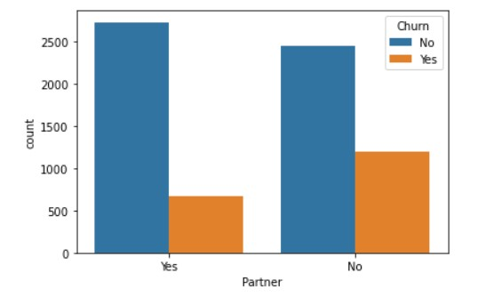
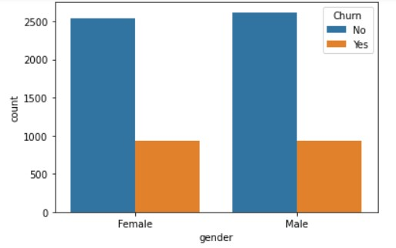
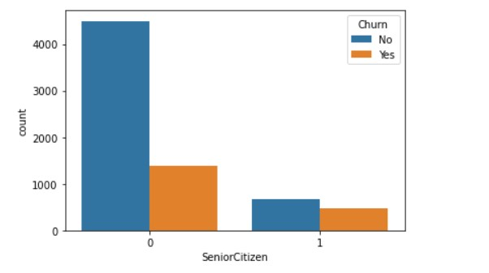
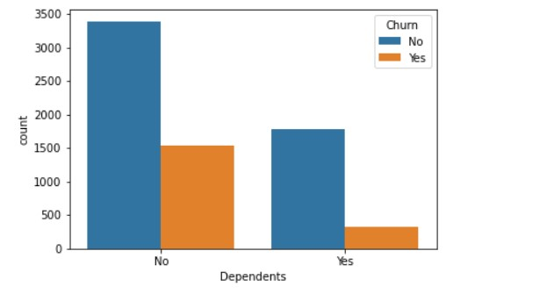
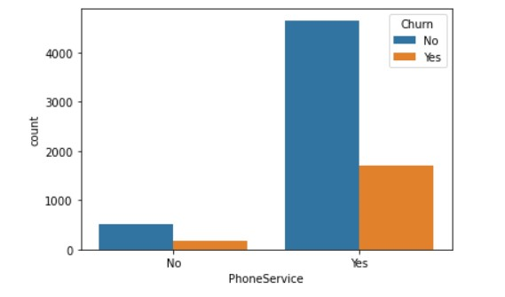
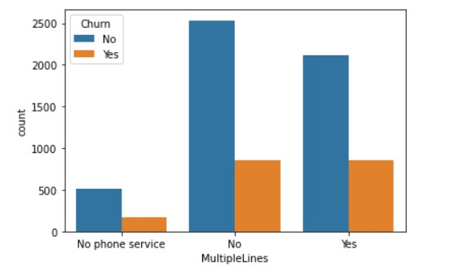
EDA

Slide 4
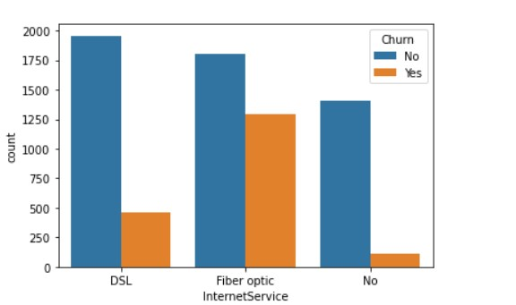
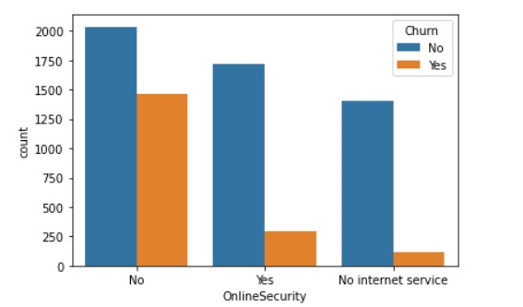
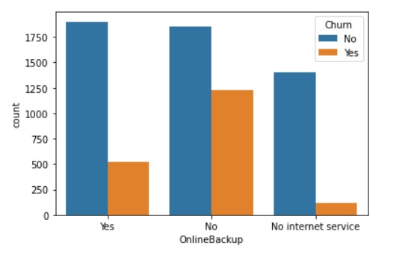
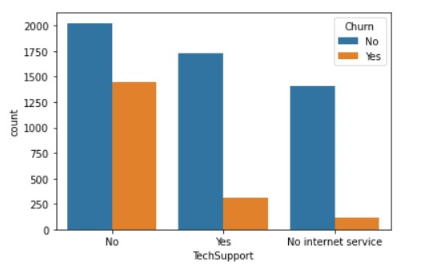
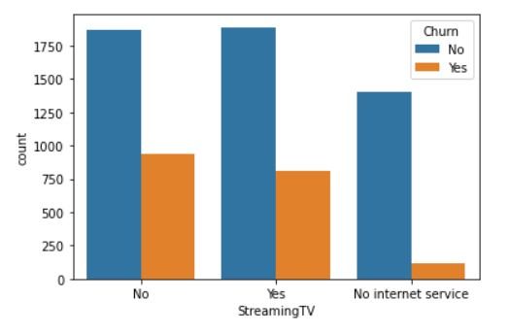
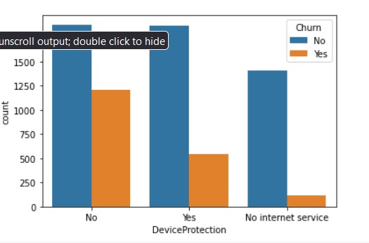

Slide 5
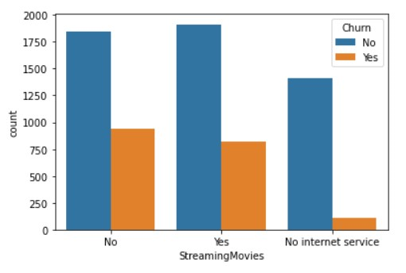
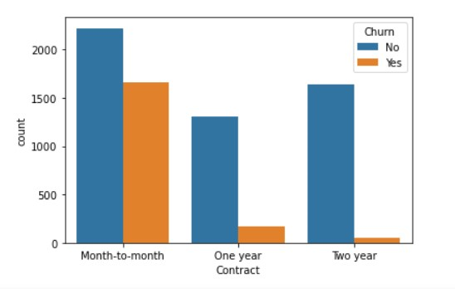
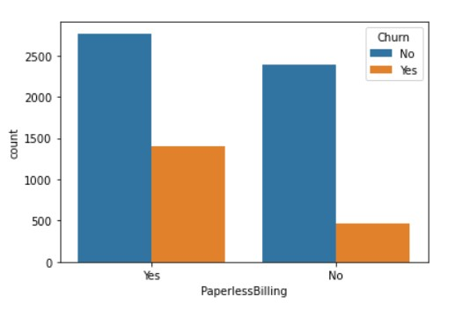
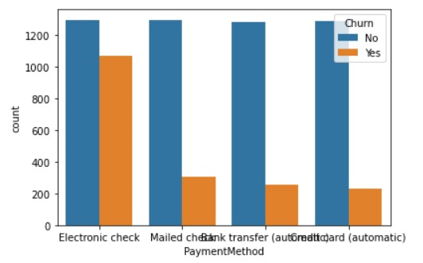
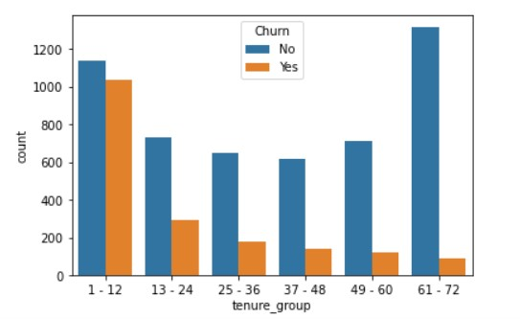
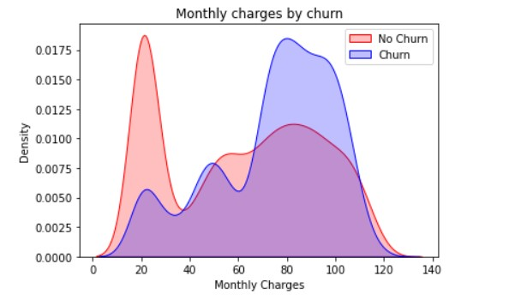

Slide 6
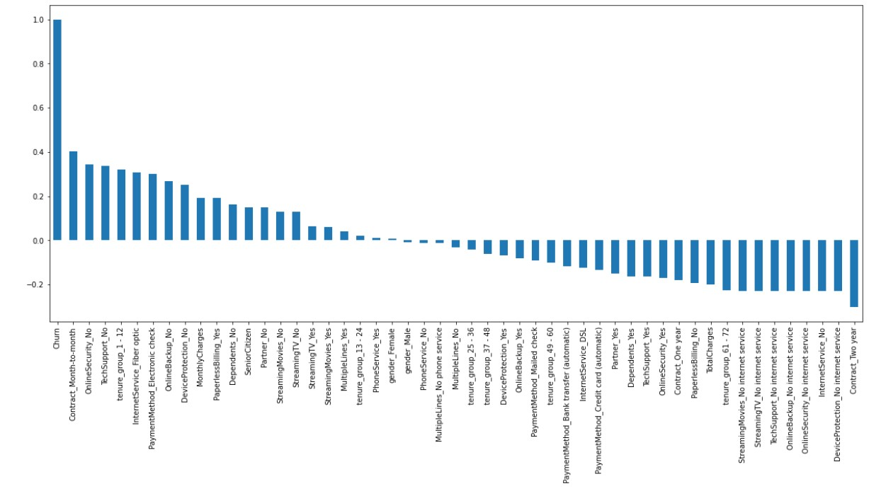

Slide 7
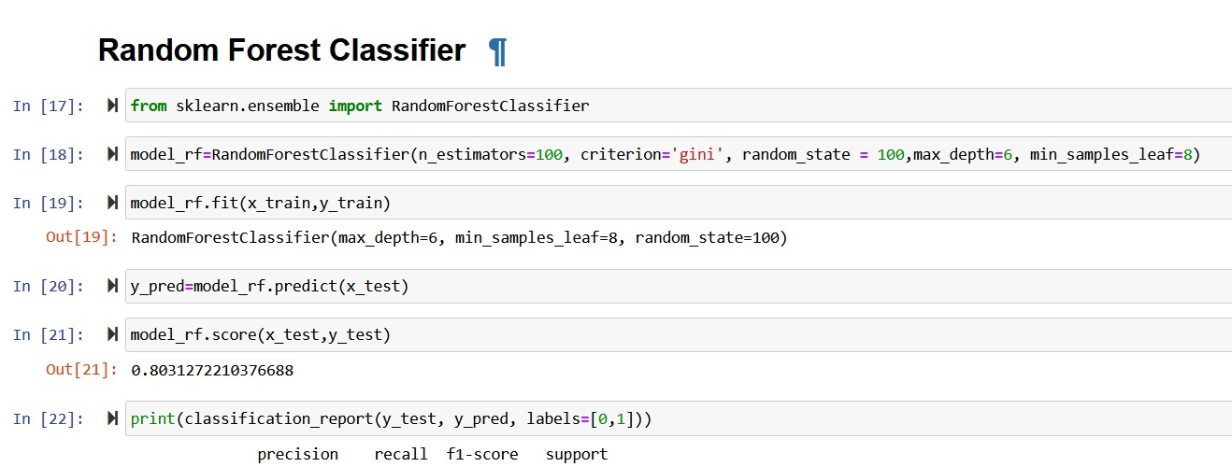
Prediction
For prediction part random forest algorithm was used as follows-

Slide 8
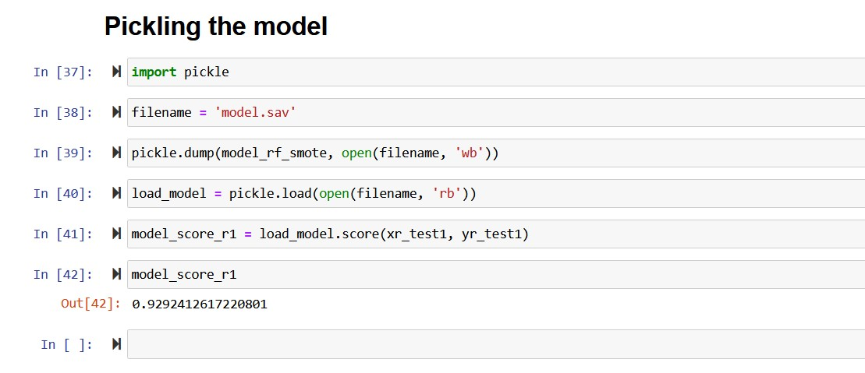
Model Preparation
In order to deploy the model, a few preparations were required, that is to make a pickle file. Which allows the model in the notebook to be converted into a byte code file, and decrypt at the time of deployment. The pickle file was created as follows:-

Slide 9
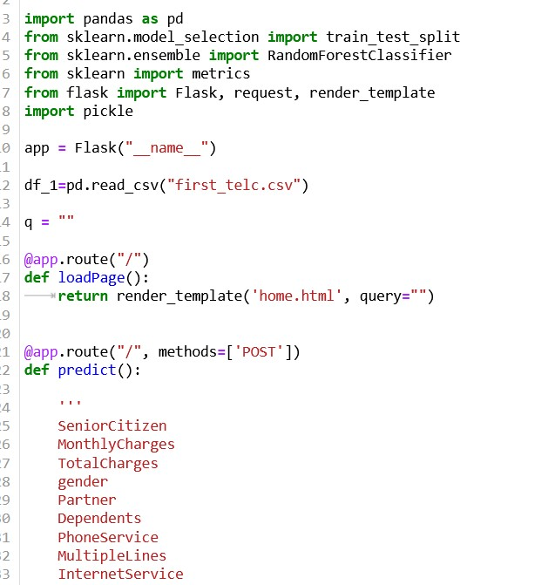
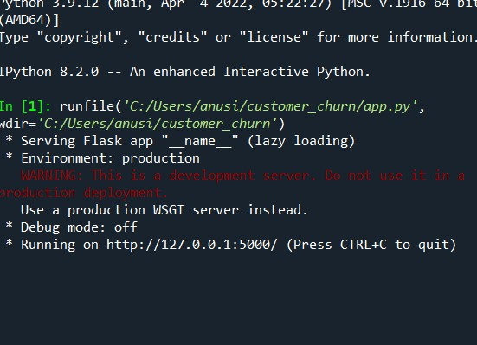
Deployment- Flask
Flask is a web application framework written in Python. For the deployment of my ml model, Flask framework was used. The model gets deployed locally.

Slide 10
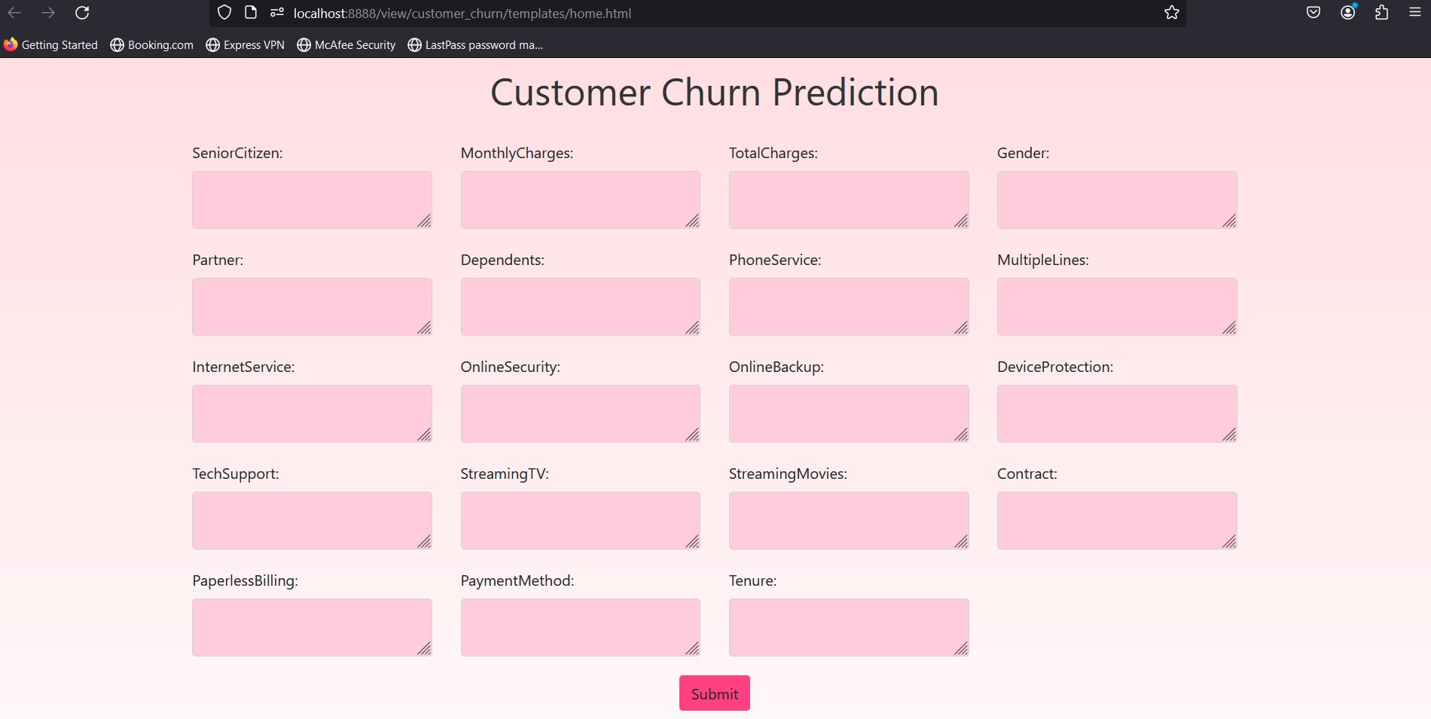
Webpage- Html
The interface created using HTML looks as-

Slide 11
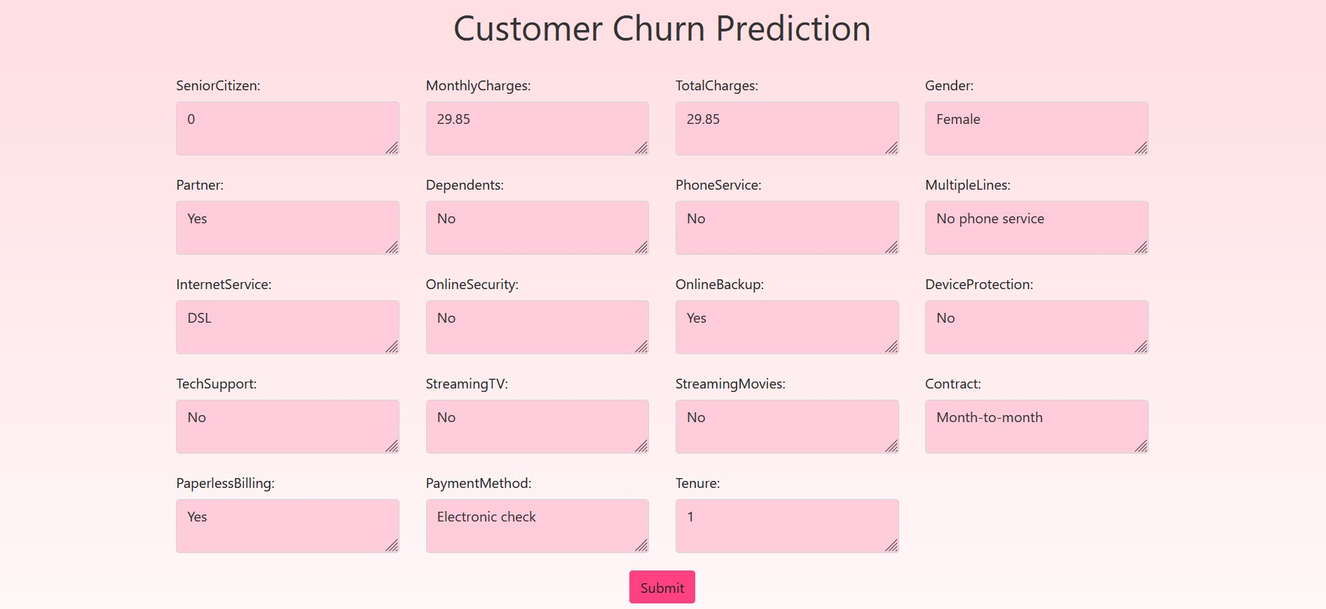
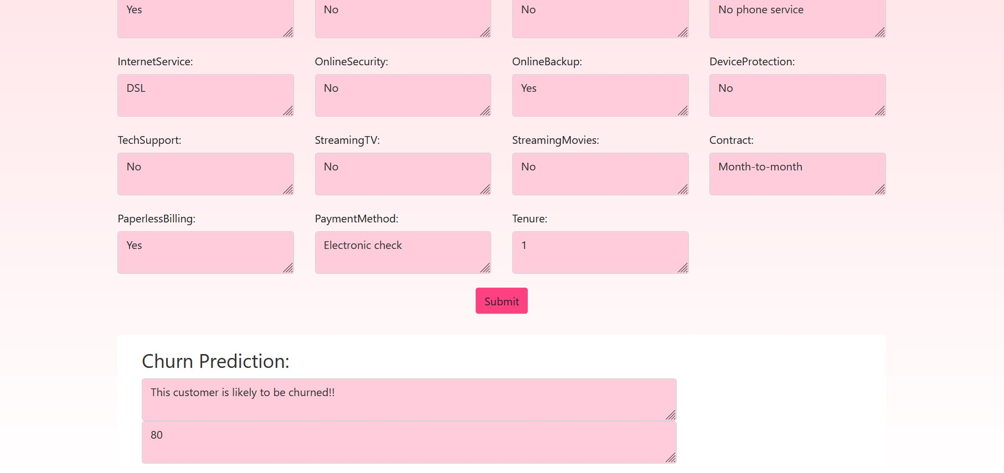

Slide 12
Conclusions
Though the model is deployed locally, still sometimes creates problems while executing, and shows some internal server errors.
To prevent these kinds of issues model can be deployed over any cloud-based platform for hosting websites.
Besides these issues, the model predicts, the customer that is most likely to be churned.
THANK YOU!!

